Slide 1
Ways to put code into actions (instructions)

Slide 2
Ways to put code into actions (instructions)

Slide 3
Ways to put code into actions (instructions)
Interpreter
Immediately
runs
Not so efficient;
can run slow

Slide 4
Ways to put code into actions (instructions)
Interpreter
Immediately
runs
Not so efficient;
can run slow

Slide 5
Ways to put code into actions (instructions)
Interpreter
Compiler
Immediately
runs
Not so efficient;
can run slow
Delay before running
Runs efficiently

Slide 6
Ways to put code into actions (instructions)
Interpreter
Compiler
Immediately
runs
Not so efficient;
can run slow
Delay before running
Runs efficiently

Slide 7
Ways to put code into actions (instructions)
Interpreter
Compiler
Just-in-time
Delay before running
Runs efficiently
Immediately
runs
Runs very efficiently
( all browsers 2008)
Immediately
runs
Not so efficient;
can run slow

Slide 8

Ways to put code into actions (instructions)
Interpreter
Compiler
Just-in-time
Delay before running
Runs efficiently
Immediately
runs
Runs very efficiently
( all browsers 2008)
Immediately
runs
Not so efficient;
can run slow

Slide 9

Ways to put code into actions (instructions)
Interpreter
Compiler
Just-in-time
Delay before running
Runs efficiently
Immediately
runs
Runs very efficiently
( all browsers 2008)
Immediately
runs
Not so efficient;
can run slow
WebAssembly
Immediately
runs highly efficiently
(MVP 2017)

Slide 10
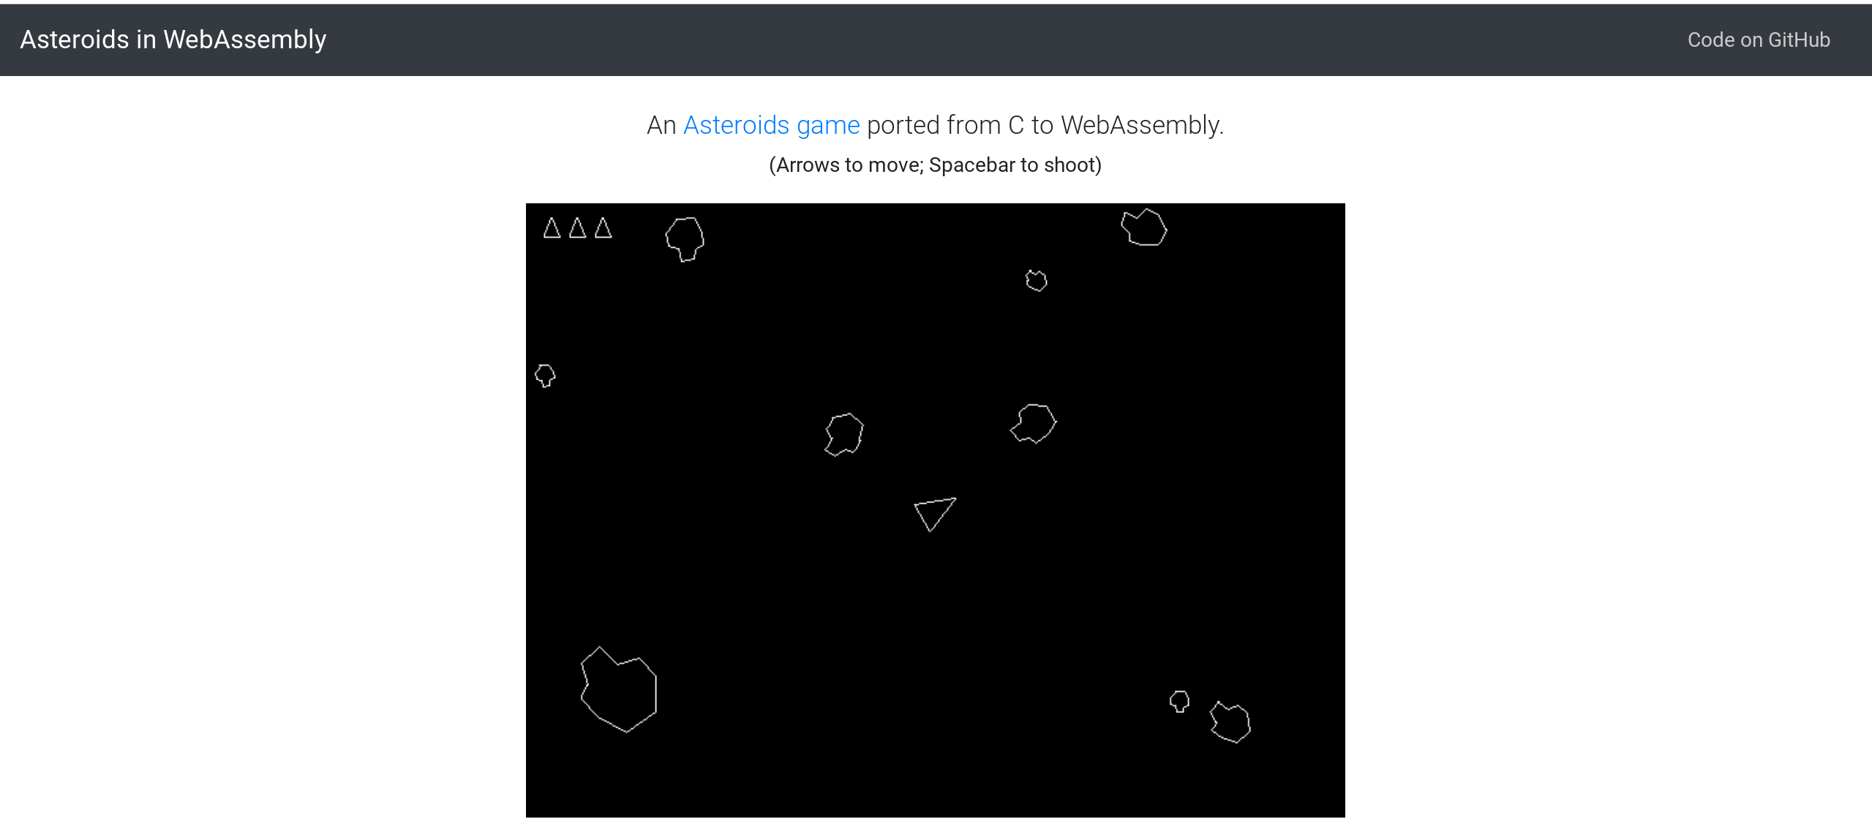

What is WebAssembly
Written in C NOT JavaScript
levelupwasm.com/apps/asteroids

Slide 11
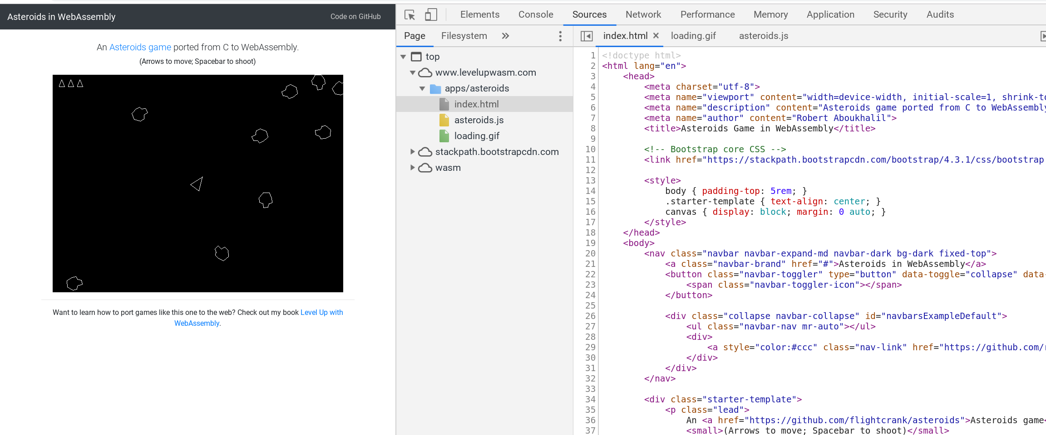
What is WebAssembly

Slide 12
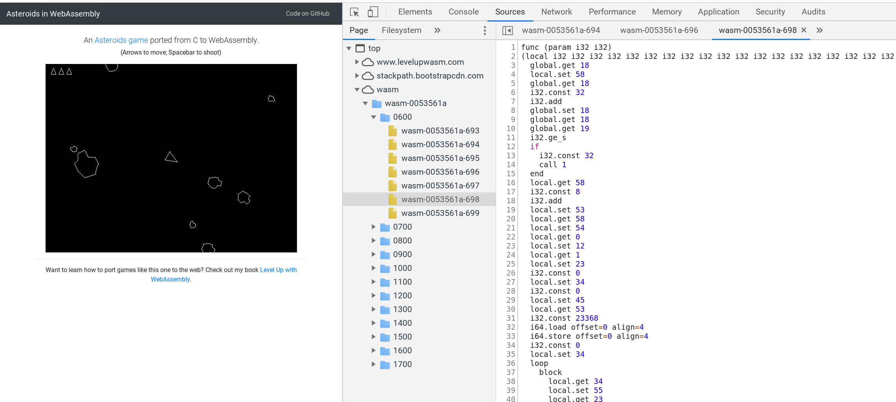
What is WebAssembly
WebAssembly code (Wasam)
Compiled (converted) from C to WebAssembly to run directly in the browser

Slide 13
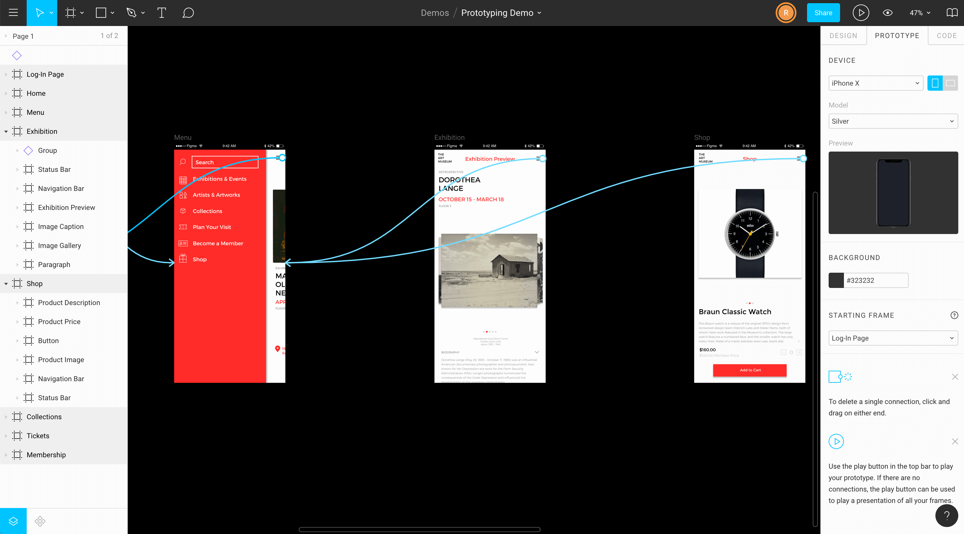
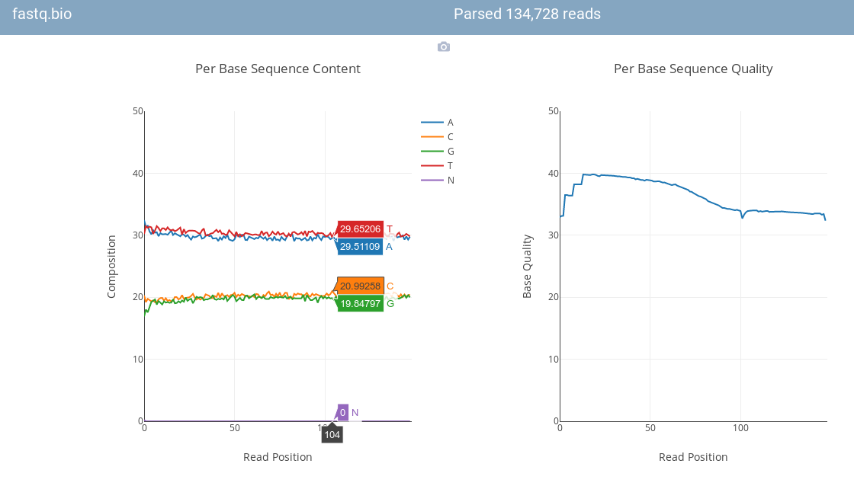
Why is WebAssembly important?
Faster than JavaScript
Figma 3X faster
fastq.bio DNA sequencer 20X faster

Slide 14
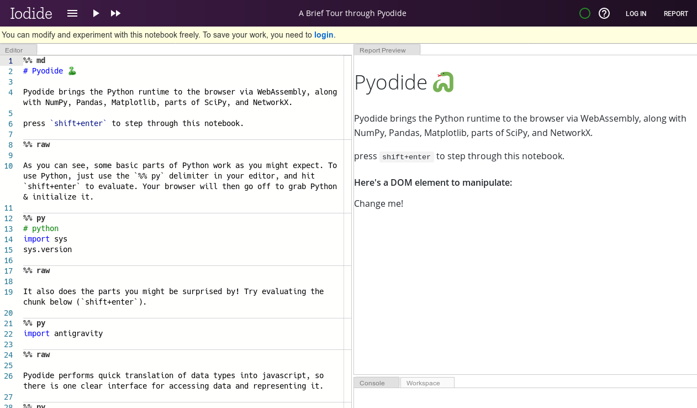
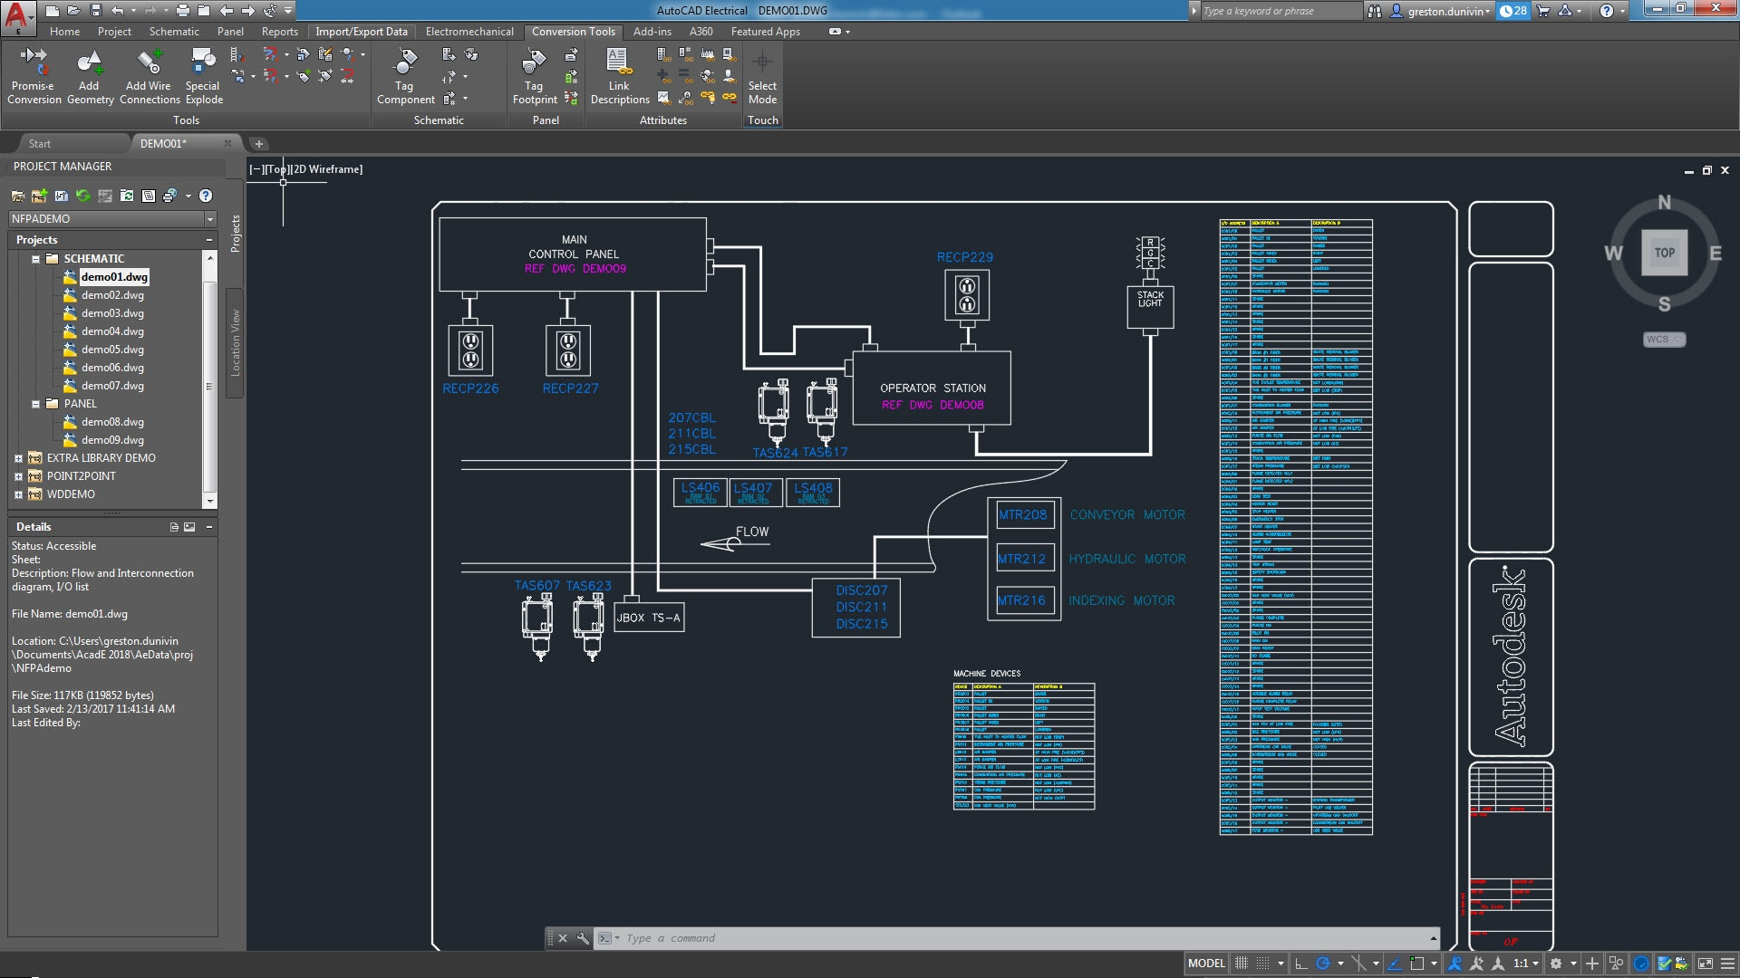

Why is WebAssembly important?
Run established codebase
Pyodide is Python running on the browser via webAssembly for scientific and AI
AutoCAD web version uses identical codebase as desktop - C

Slide 15
TL;DR
WebAssembly Code is ‘shipped in’ via a binary blob
Allows faster execution than JavaScript
Allows established non JavaScript code via compiler to run on the web

